Slide 1
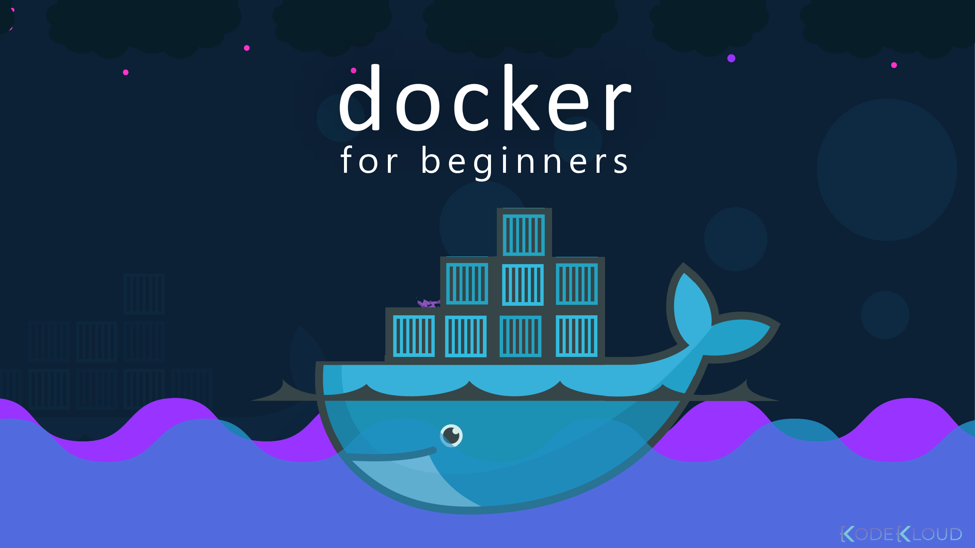


BY: Mohamed ElSabagh

Slide 2
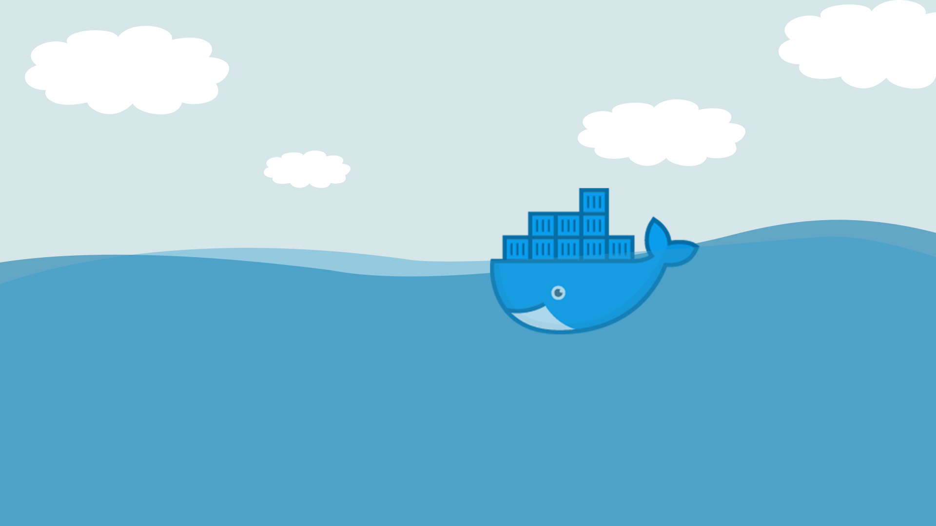
Agenda :
Docker Image
DockerFile
Image Layers
Docker Networks
Lab

Slide 3

Docker Images

Slide 4
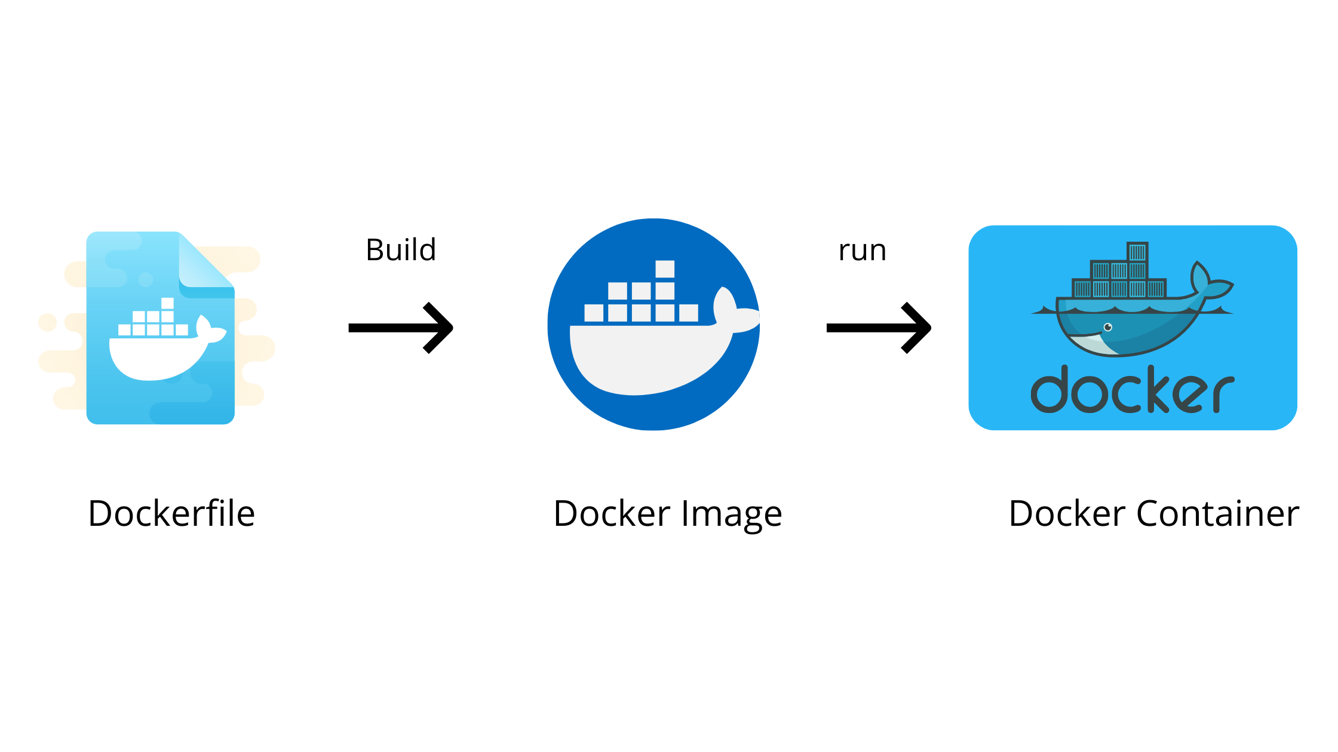
Custom Images
To create our own image, we can do one of the following:
Create a container from your desired image, add and edit
whatever you want then commit all these changes to an image.
docker commit CONTAINER_ID new_image_name
Use Dockerfile

Slide 5
Dockerfile
Dockerfiles are instructions. They contains all commands used to build an image.
Each represents a Dockerfile instruction.
Each layer is a result of the changes from the previous layer.

Slide 6

.

Slide 9
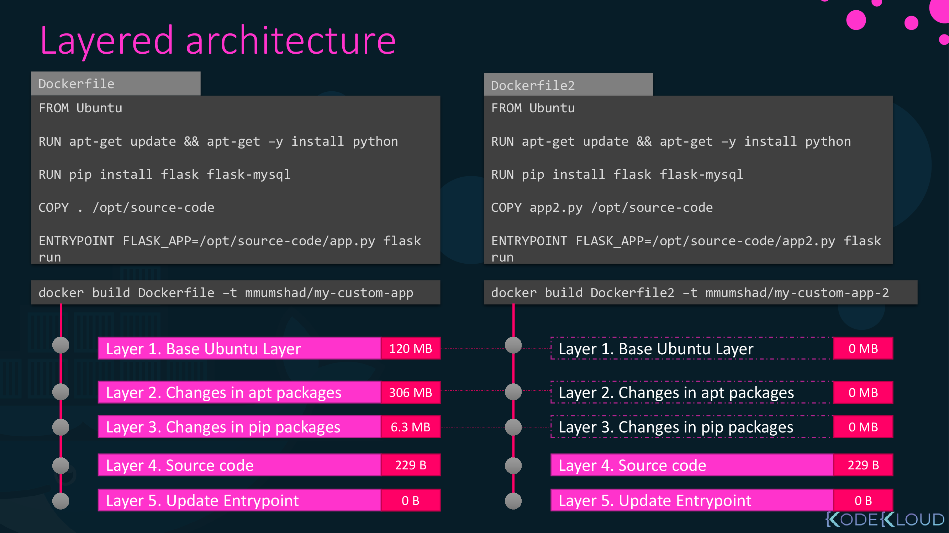

Slide 10
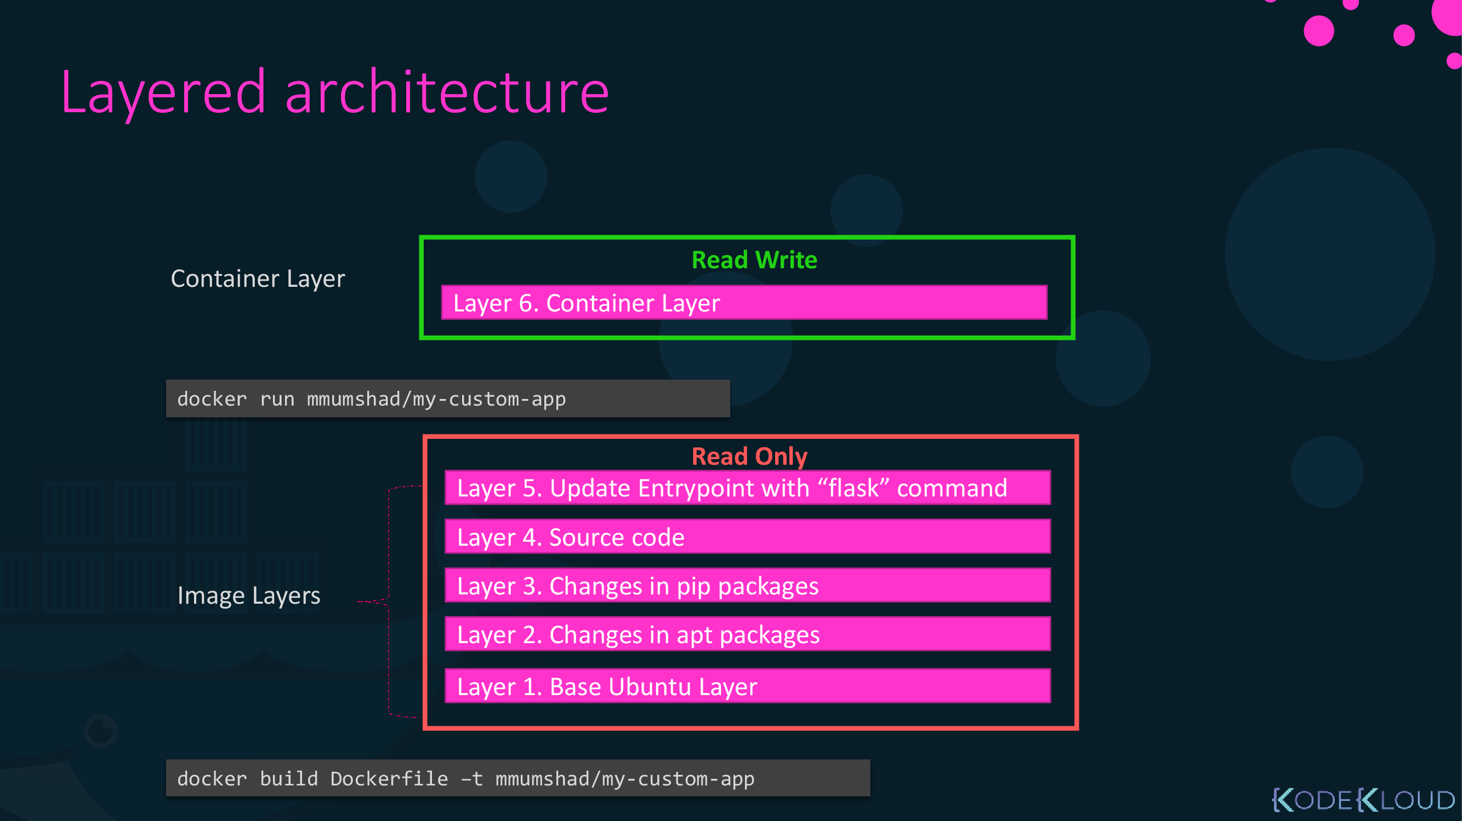

Slide 12
Dockerfile instructions
FROM: Initializes a new build stage and sets the Base Image
RUN: Will execute any OS commands in a new layer to build the image
CMD:
Provides a default for an executing container.
There can only be one CMD instruction in a Dockerfile.
Only the last CMD will have an effect.
ENTRYPOINT:
Allows for configuring a container that will run as an executable
There can only be one CMD instruction in a Dockerfile.
Only the last CMD will have an effect.
EXPOSE: Informs Docker that the container listens on the specified network ports at runtime
ENV: Sets the environment variable <key> to the value <value>
ADD: Copies new files, directories or remote file URLs from <src> and adds them to the filesystem of the image at the path <dest>.
COPY: Copies new files or directories from <src> and adds them to the filesystem of the container at the path <dest>.

Slide 13
Dockerfile instructions
LABEL: Adds metadata to an image
VOLUME: Creates a mount point with the specified name and marks it as holding externally mounted volumes from native host or other containers
USER: Sets the username (or UID) and optionally the user group (or GID) to use when running the image and for any RUN, CMD,
WORKDIR:
Sets the working directory for any RUN, CMD, ENTRYPOINT, COPY, and ADD instructions that follow it in the Dockerfile
If the WORKDIR doesn’t exist, it will be created even if it’s not used in any subsequent Dockerfile instruction.
ARG:
An ARG instruction goes out of scope at the end of the build stage where it was defined
Defines a variable that users can pass at build-time to the builder with the docker build command, using the --build-arg <varname>=<value> flag
is the only instruction that may precede FROM in the Dockerfile.
ONBUILD: Adds a trigger instruction to the image that will be executed at a later time, when the image is used as the base for another build

Slide 14
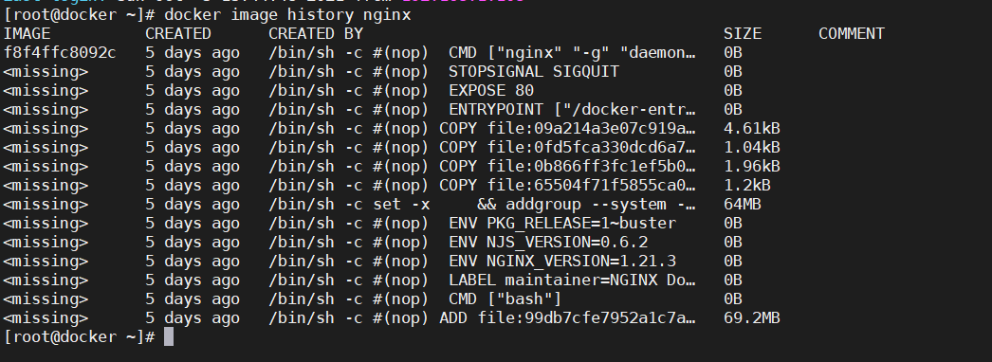
To see image layers :
Run the following command :
$docker image history image-name

Slide 15

RUN VS CMDVS ENTERYPOINT
RUN. Mainly used to build images and install applications and packages. Builds a new layer over an existing image by committing the results.
CMD. Sets default parameters that can be overridden from the Docker Command Line Interface (CLI) when a container is running.
ENTRYPOINT. Default parameters that cannot be overridden when Docker Containers run with CLI parameters.

Slide 17
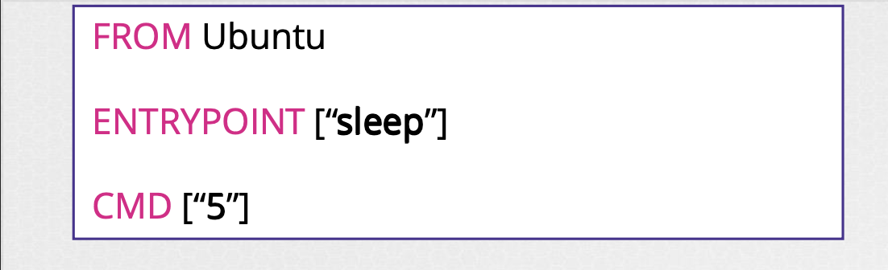

Slide 18
ADD VS COPY
COPY VS ADD
ADD lets you do that too, but it also supports 2 other sources. First, you can use a URL instead of a local file/directory. Secondly, you can extract tar from the source directory into the destination.
COPY takes in a src and destination. It only lets you copy in a local or directory from your host (the machine-building the Docker image) into the Docker image itself.

Slide 20
To push image to docker hub :
$docker image tag nginx user/nginx
$docker login
$docker push user/nginx

Slide 21
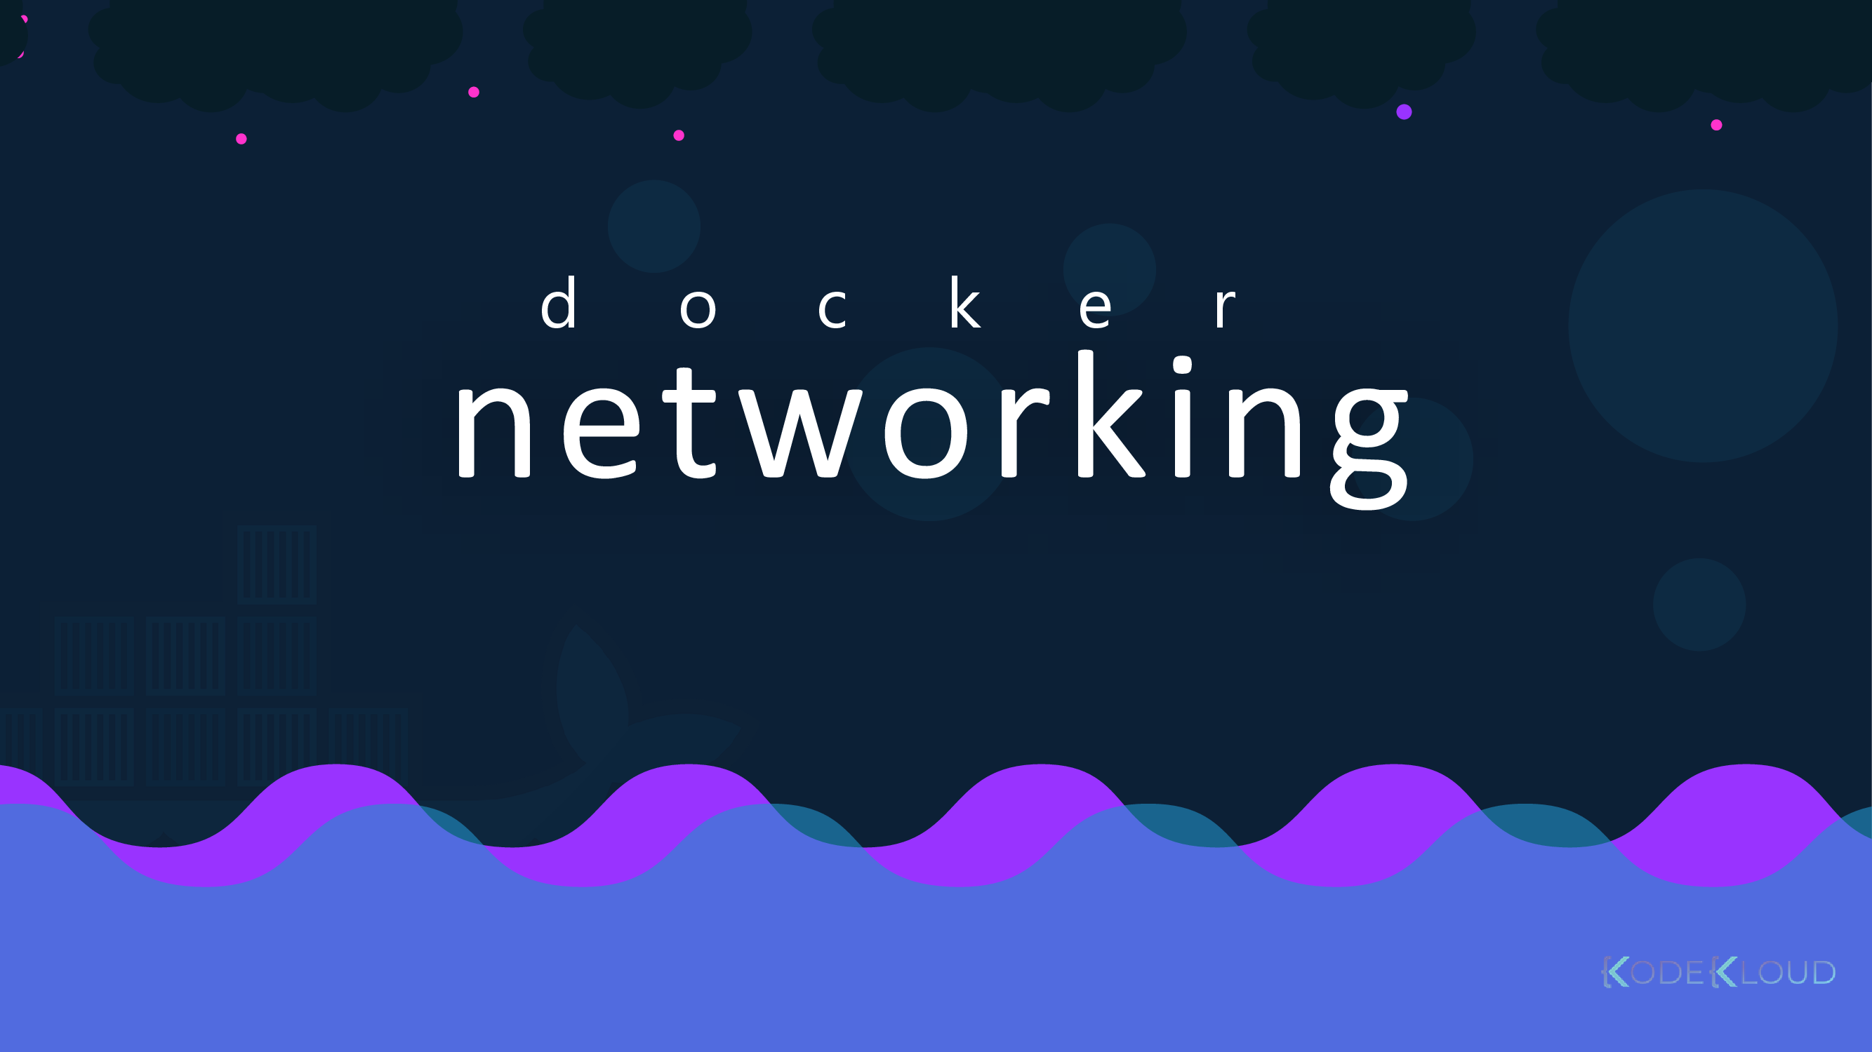

Slide 22
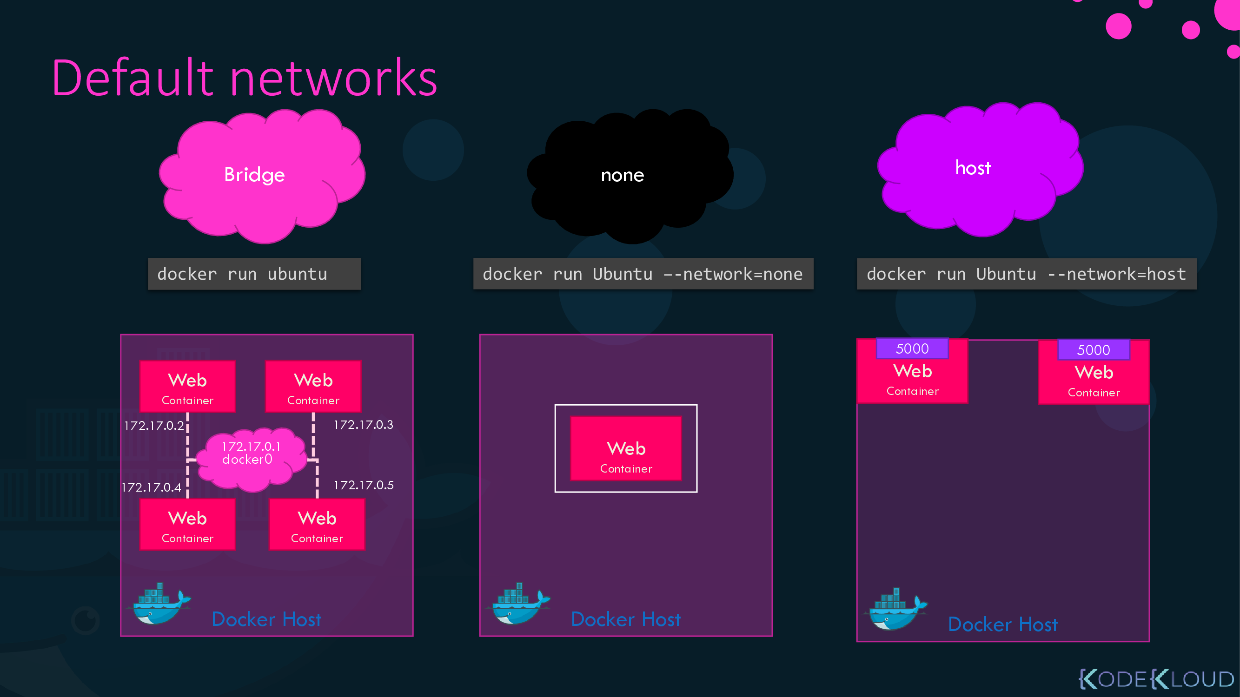

Slide 23
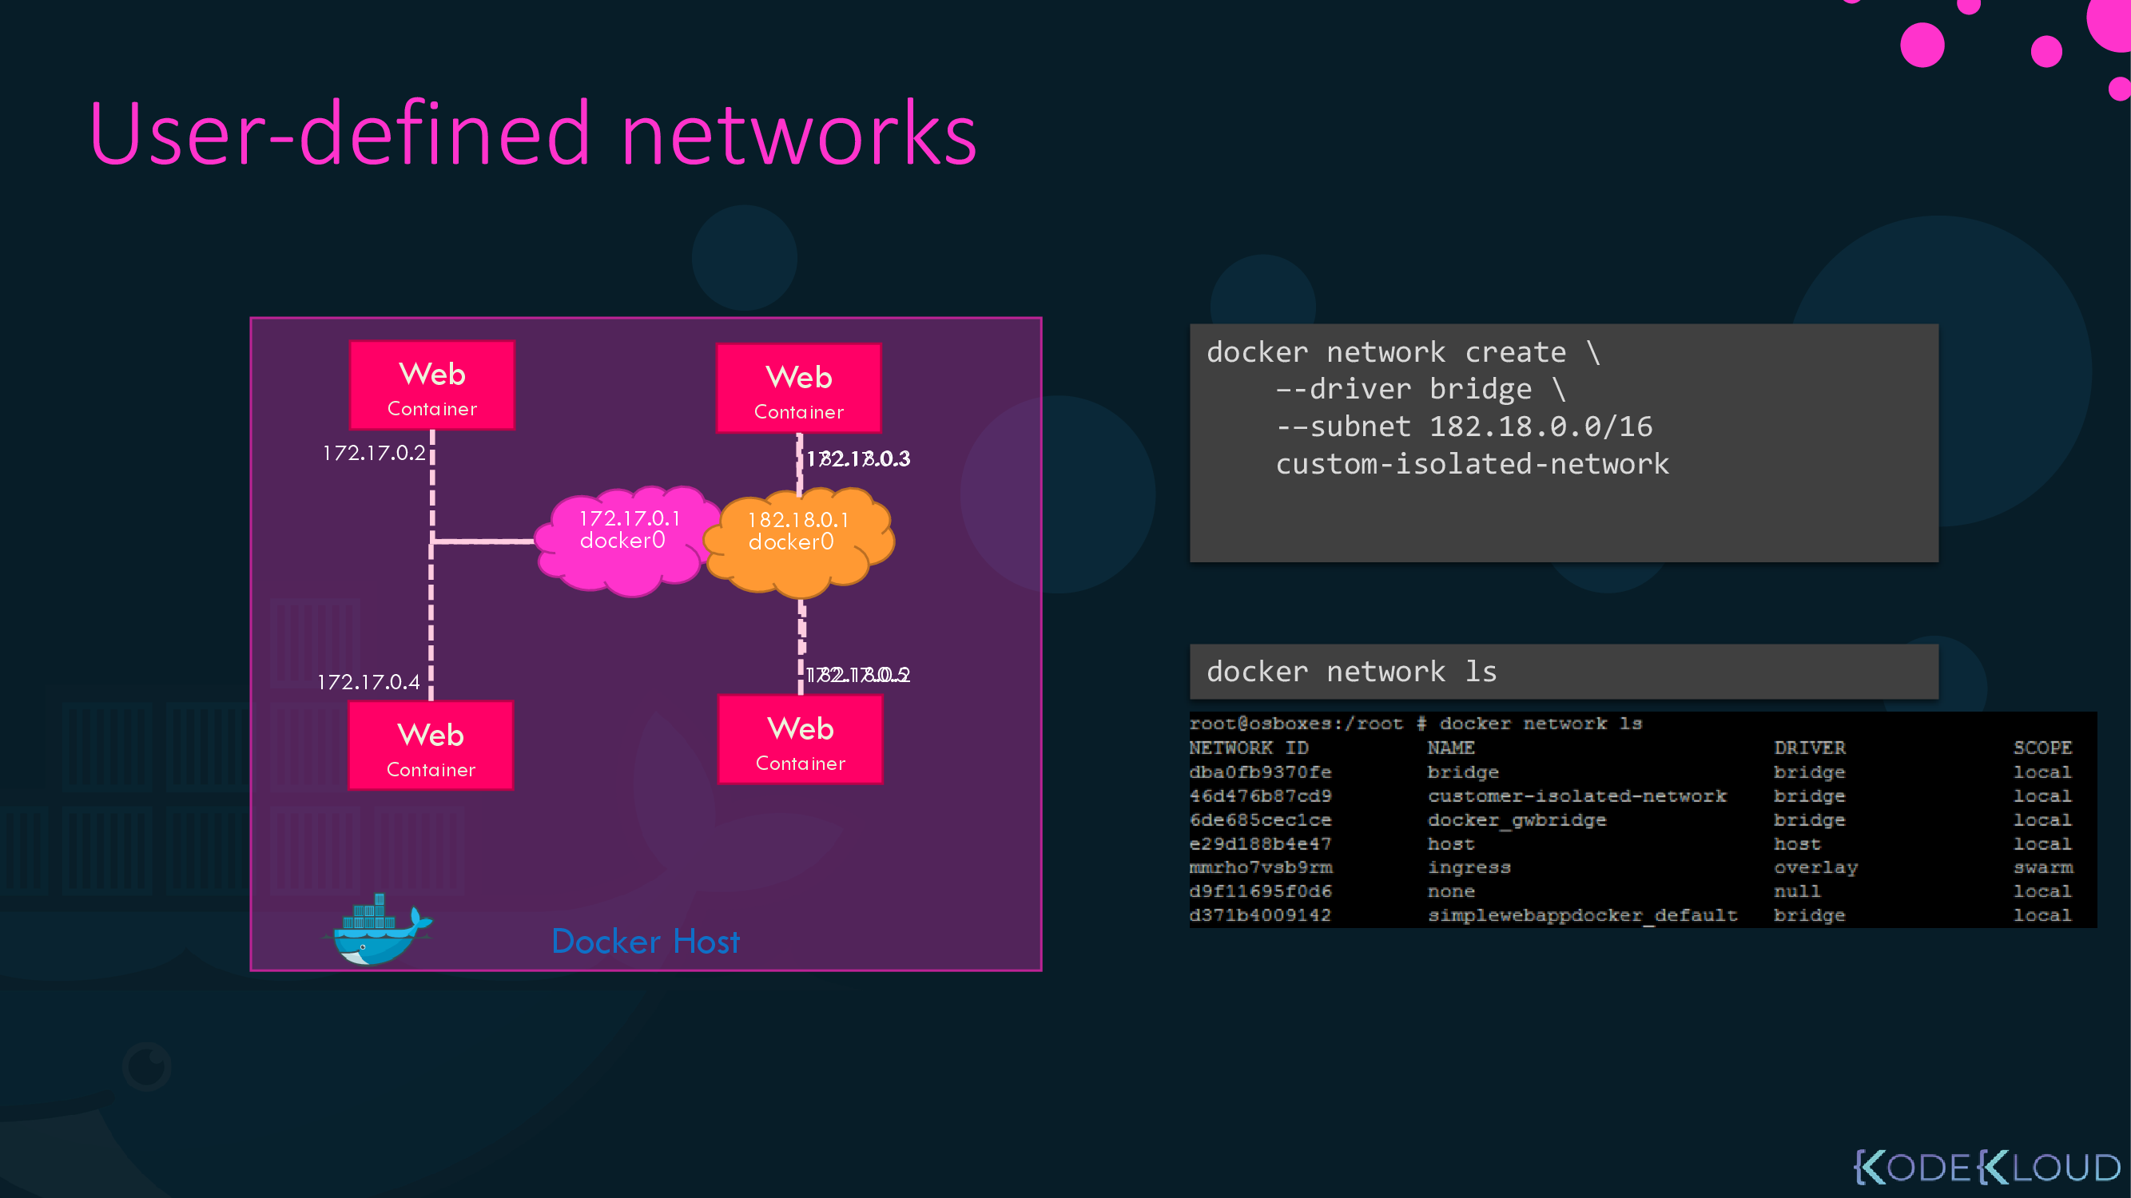

Slide 24
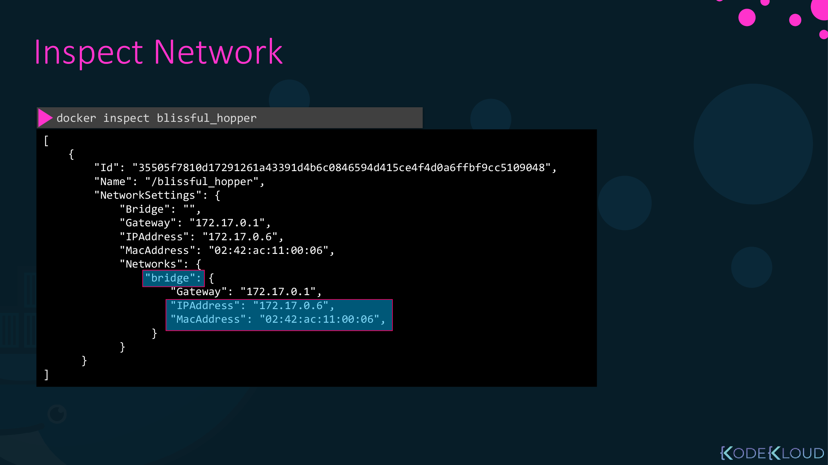

Slide 25
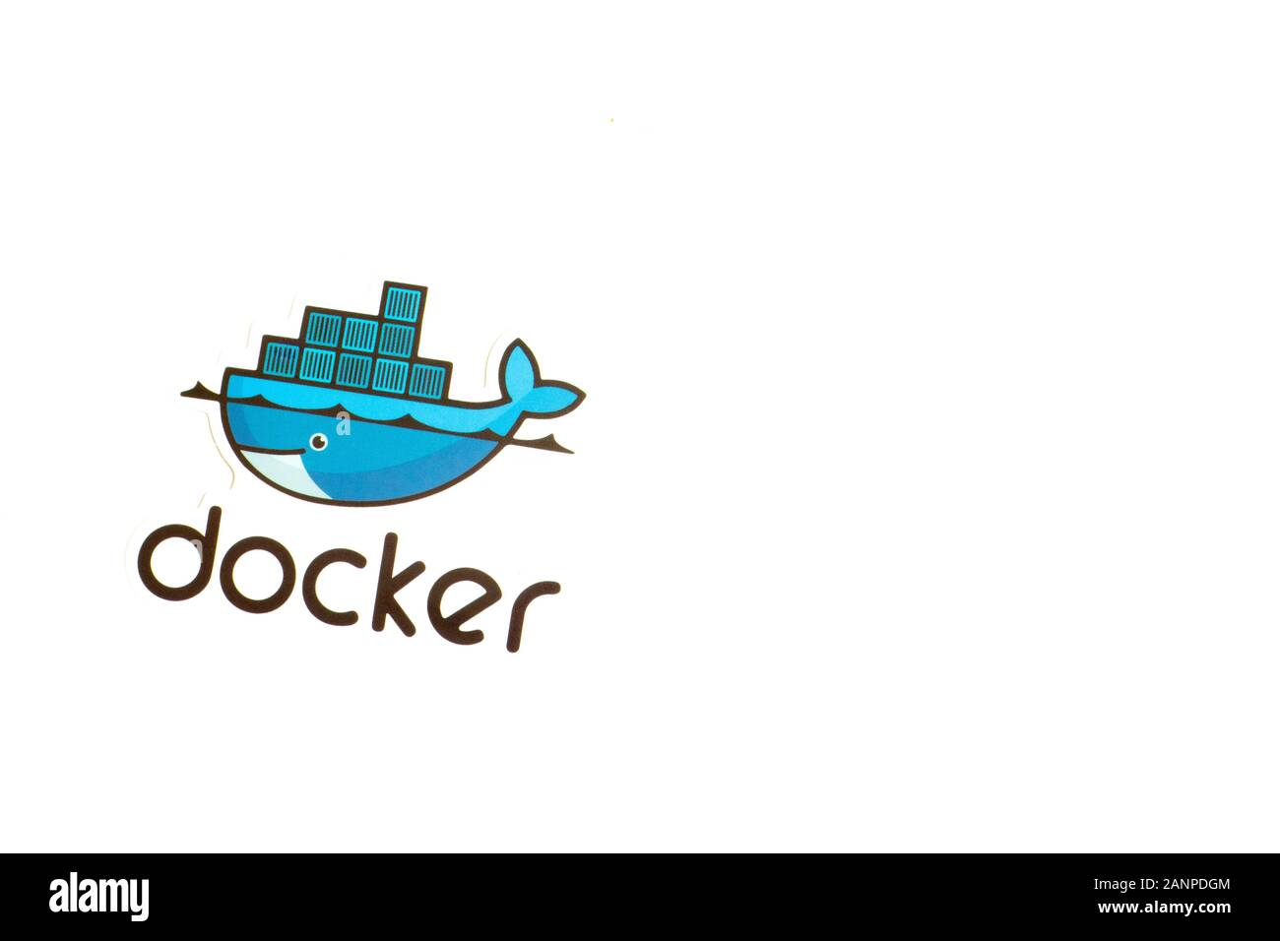
Docker Networks
Bridge:
Private internal network created by docker on the host.
Default network the container attach to.
Each created container get internal IP address usually in range 172.17.x.x.
Containers can access each. Others by this IP
To Access any of these containers “PORT MAPPING”
By adding –p port-outside:port-inside when running the container
Host:
No type of isolation between docker container and docker host
No need to “PORT MAPPING”
Only one docker container can be access

Slide 26
Docker Networks
None:
Docker container not attached to any network
It will not be accessible outside even from other containers
overlay:
Create new internal private network that allow all containers to access each others.
Docker Swarm can create it.
Docker network create --driver overlay --subnet 10.0.9.0/24 name
Then attach the container or services to this network during creation

Slide 27
Lab
P1: Create your own nginx docker image based on ubuntu “NEVER USE FROM nginx”
Install nginx
copy index.html as file to "/usr/share/nginx/html” with message “”
Start nginx
Expose port
Docker push to your register on dockerhub
P2: What is the rest of Docker Networks ? “Name and Definition”
P3: Create your bridge network, two containers from ubuntu image with different names and try to ping each other using NAME.

Slide 28
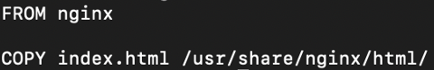
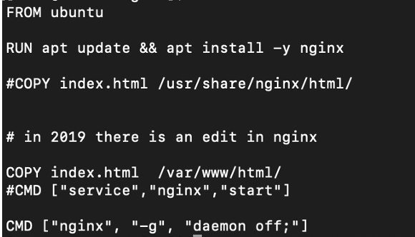
Lab
1- create Dockerfile to create nginx , replace override index.html of nginx with content “ Hello ITI heros from Dockerfile”
2-repeate previous task without using NGINX as a base , use ubuntu

Slide 29
Lab
3- create cutom nginx image “DON’T USE NGINX AS BASE” with the following needs :
Create Dockerfile with name Dockerfile9090
Dockerfile will have the following steps :
Use alpine as your Base
Run following commands “ apk update. ,AND apk add nginx”
Create Directory called /data
Compress the file index.html to index.html.tar.gz
Copy index.html.tar.gz file to /data
Copy the nginx-9090.conf file to /etc/nginx/http.d/
Expose port 9090
Use command to start the image ➔ nginx -g daemon off;
Tag image with nginx9090
Image run container in background with name nginx-container-9090 and can listen from outside on port 8080

Slide 30
nginx-9090.conf
server {
listen 9090;
server_name example.com;
index index.html;
location / {
root /data;
}
}
Index.html
<p> Hello , ITI heroes . This nginx listen on port 9090 </p>

Slide 31
Cat Dockerfile9090
FROM alpine
RUN apk update && apk add nginx
WORKDIR /data
ADD index.html.tar.gz /data
COPY nginx-9090.conf /etc/nginx/http.d/
EXPOSE 9090
CMD ["nginx", "-g", "daemon off;"]
$ tar -czvf index.html.tar.gz index.html
$ docker build -t nginx9090 -f Dockerfile.9090 .
$ docker run -d -p 8080:9090 --name nginx-container nginx9090

Slide 34
Install Docker-compose
Go to link https://docs.docker.com/compose/install/linux/
Install dockercompose

Slide 35
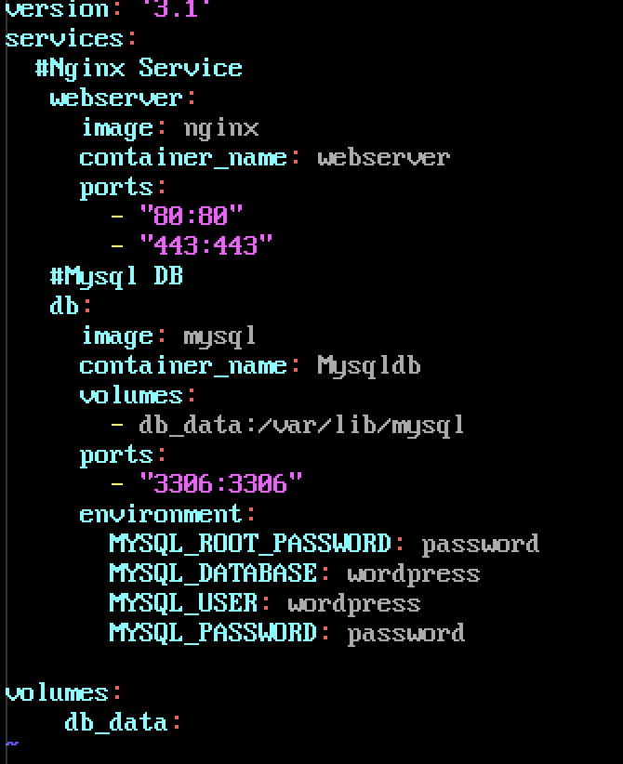
Docker-compose.yml
This is an example of creating 2 containers
First container is webserver
Start nginx server
Second container is Mysqldb
Run mysql db
To build use :
$docker compose up

Slide 36
Thank You

